Slide 1
Barchart Infographics
Here is where this template begins
This template has been created by Slidesgo

Slide 2
Barchart Infographics
Jupiter
Mars
50%
25%
60%
90%
25%
100%
90%
50%
This template has been created by Slidesgo

Slide 3
Barchart Infographics
Mercury is the closest planet to the Sun
100%
Venus is the second planet from the Sun
75%
Earth is the third planet from the Sun
50%
Despite being red, Mars is actually a cold place
25%
This template has been created by Slidesgo

Slide 4
Barchart Infographics
Mercury is the closest planet to the Sun
3/10
Venus is the second planet from the Sun
5/10
Earth is the third planet from the Sun
9/10
Despite being red, Mars is actually a cold place
10/10
This template has been created by Slidesgo

Slide 5
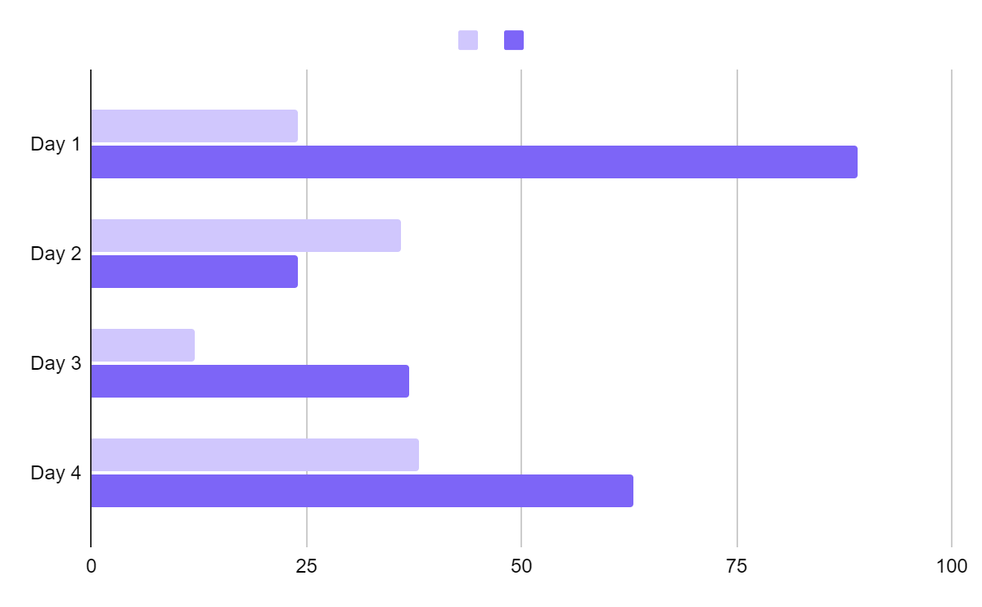
Barchart Infographics
Mercury
Mercury is the closest planet to the Sun
Venus
Venus is the second planet from the Sun
Follow the link in the graph to modify its data and then paste the new one here. For more info, click here
This template has been created by Slidesgo

Slide 6
Barchart Infographics
100%
Mercury is the closest planet to the Sun
75%
Venus is the second planet from the Sun
25%
Earth is the third planet from the Sun
90%
Despite being red, Mars is actually a cold place
This template has been created by Slidesgo

Slide 7
Barchart Infographics
100%
Mercury
50%
Earth is the third planet from the Sun
80%
Venus
60%
Mercury is the closest planet to the Sun
100%
100%
Mars
Despite being red, it’s actually a cold place
50%
20%
Jupiter
Venus is the second planet from the Sun
This template has been created by Slidesgo

Slide 8
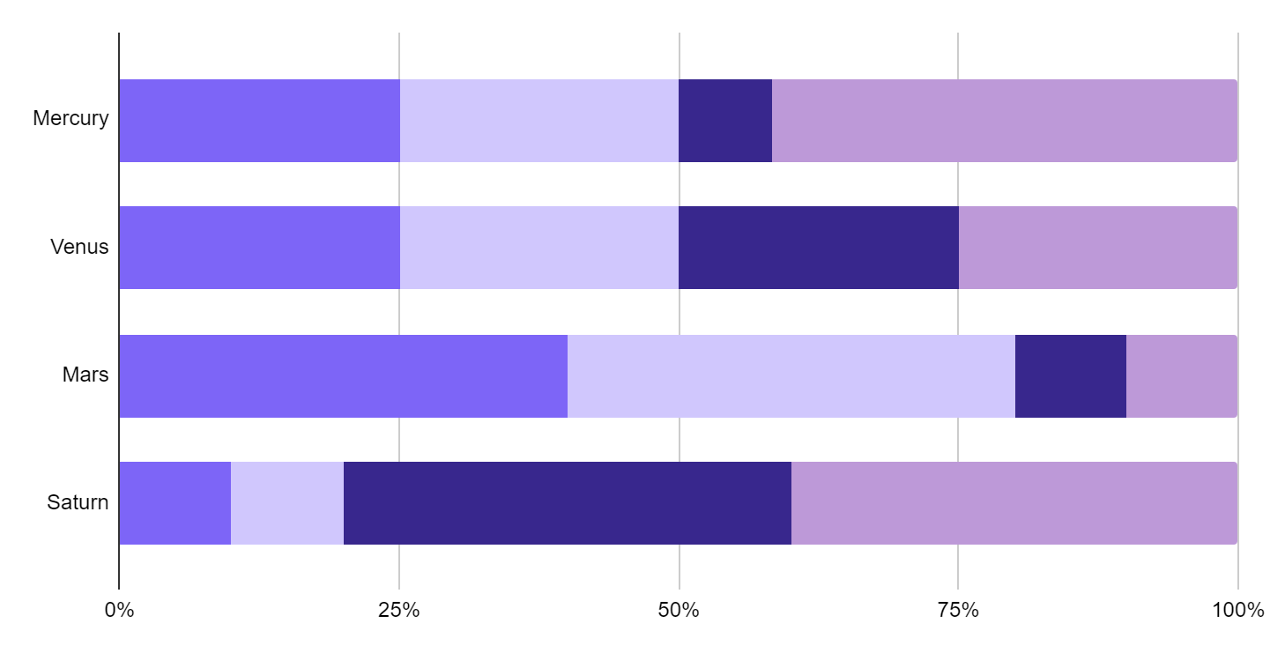
Barchart Infographics
30%
10%
10%
50%
25%
25%
25%
25%
40%
40%
10%
10%
10%
10%
40%
40%
Follow the link in the graph to modify its data and then paste the new one here. For more info, click here
This template has been created by Slidesgo

Slide 9
Barchart Infographics
50%
Step 1
Step 2
Step 3
Step 4
Mercury is the closest planet to the Sun
Mercury is the closest planet to the Sun
Mercury is the closest planet to the Sun
Mercury is the closest planet to the Sun
This template has been created by Slidesgo

Slide 10
Barchart Infographics
Task 1
Task 2
Task 3
Task 4
Jan | Feb | Mar | Apr | May | Jun | Jul | Aug | Sep | Oct | Nov | Dec
This template has been created by Slidesgo

Slide 11
Barchart Infographics
Barchart table showing 5 options
Mercury is the closest planet to the Sun | 90%
Venus is the second planet from the Sun | 40%
Earth is the third planet from the Sun | 60%
Despite being red, Mars is actually a cold place | 100
Saturn is a gas giant and has several rings | 90%
This template has been created by Slidesgo

Slide 12
Barchart Infographics
Mercury is a small planet
25%
75%
Mercury
Neptune
Venus is a hot planet
50%
50%
Earth
Mars
We all live on Earth
75%
25%
Jupiter
Saturn
This template has been created by Slidesgo

Slide 13
Barchart Infographics
Mercury is the closest planet to the Sun
100%
Venus is the second planet from the Sun
80%
Earth is the third planet from the Sun
60%
Saturn is a gas giant and has several rings
40%
Despite being red, Mars is actually a cold place
20%
This template has been created by Slidesgo

Slide 14
Barchart Infographics
100%
Venus is the second planet from the Sun
75%
50%
100%
Earth is the third planet from the Sun
50%
100%
50%
Saturn is a gas giant and has several rings
75%
25%
Mercury
Venus
Mars
This template has been created by Slidesgo

Slide 15
Barchart Infographics
Mercury is the closest planet to the Sun
Saturn is a gas giant and has several rings
100%
80%
Venus is the second planet from the Sun
Despite being red, Mars is actually a cold place
100%
40%
Earth is the third planet from the Sun
Neptune is the eighth planet from the Sun
80%
20%
This template has been created by Slidesgo

Slide 16
Barchart Infographics
100%
Venus is the second planet from the Sun
75%
2001
75%
100%
Earth is the third planet from the Sun
50%
2005
50%
Mercury
Venus
Mars
This template has been created by Slidesgo

Slide 17
Barchart Infographics
Venus is the second planet from the Sun
50%
Earth is the third planet from the Sun
100%
Saturn is a gas giant and has several rings
70%
This template has been created by Slidesgo

Slide 18
Barchart Infographics
Venus is the second planet from the Sun
50%
20%
30%
Earth is the third planet from the Sun
25%
25%
50%
0%
25%
75%
Saturn is a gas giant and has several rings
40%
30%
30%
This template has been created by Slidesgo

Slide 19
Barchart Infographics
01
Mercury
02
Mars
100%
100%
75%
50%
75%
80%
03
Venus
04
Jupiter
25%
100%
75%
50%
100%
75%
Mercury
Venus
Mars
This template has been created by Slidesgo

Slide 20
Icon pack
This template has been created by Slidesgo

Slide 21
Instructions for use (premium users)
As a Premium user, you can use this template without attributing Slidesgo
You are allowed to:
Modify this template
Use it for both personal and commercial projects
Share this template in an
editable format
Hide or delete the “Thanks” slide and the mention to Slidesgo in the credits
You are not allowed to:
Sublicense, sell or rent any of Slidesgo Content
Distribute Slidesgo Content unless it has been expressly authorized by Slidesgo
Use any of the elements that are part in a separated way
Register any of the elements as a trademark or logo in an intellectual property registry
For more information about editing slides, please read our FAQs or visit our blog

Slide 22
Infographics
You can add and edit some infographics to your presentation to present your data in a visual way.
Choose your favourite infographic and insert it in your presentation using Ctrl C + Ctrl V or Cmd C + Cmd V in Mac
Remember to choose the “Keep source formatting” option so that it keeps the design. For more info, please visit our blog
01
07
Select one of the parts and ungroup it by right-clicking and choosing “Ungroup”
Repeat the steps above with the other parts and when you’re done editing, copy the end result and paste it into your presentation
02
06
03
Change the color by clicking
on the paint bucket
05
Group the elements again by selecting them, right-clicking and choosing “Group”
Then resize the element by clicking and dragging one of the square-shaped points of its bounding box (the cursor should look like a double-headed arrow). Remember to hold Shift while dragging to keep the proportions
04

